Slide 1
Microsoft Azure/ Visual Studio Roadshow
Dan Fluet
Cloud Practice Director
Stephen Kimble
Senior Azure Consultant

Slide 2
Agenda
Service Fabric
Event Hub, Stream Analytics
Component Integration
with Logic Apps

Slide 3
Azure Service Fabric

Slide 4
.NET Core 1.0
There are only two hard things in Computer Science: cache invalidation and naming things. - Phil Karlton
ASP.NET Core 1.0; .NET Core 1.0; Entity Framework Core 1.0
Cross-platform
Rebuilt from ground up
Goodbye, IIS; hello, OWIN
Notes:
So a quick primer on .NET Core – it’s the latest and greatest from Microsoft and the path for new development moving forward
I shamelessly ripped that quote from Scott Hanselman’s blog announcing .NET Core
.NET Core replaces .NET 5, ASP.NET Core replaces ASP.NET 5
.NET 4.6 still exists and has more functionality and is more stable than Core, but you can expect the functionality and stability gap to narrow over time
Cross-Platform: the .NET runtime runs on many different platforms – RedHat, Ubuntu, etc
Rebuilt for scalability, better support for dependency injection
IIS is no more; OWIN (Open Web Interface for .NET) is used now, with Microsoft’s implementation called Katana

Slide 5
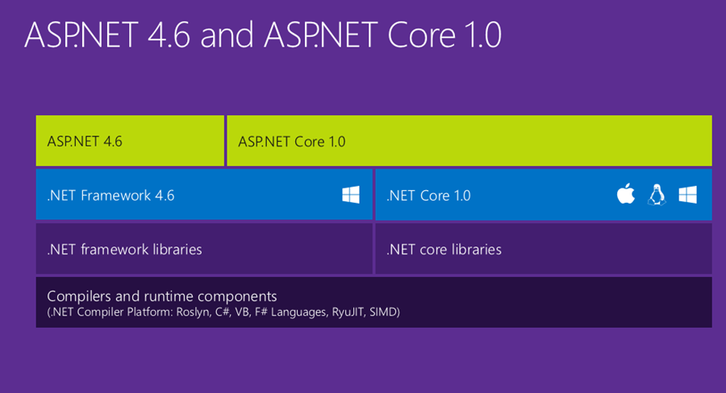
.NET Core

Slide 6
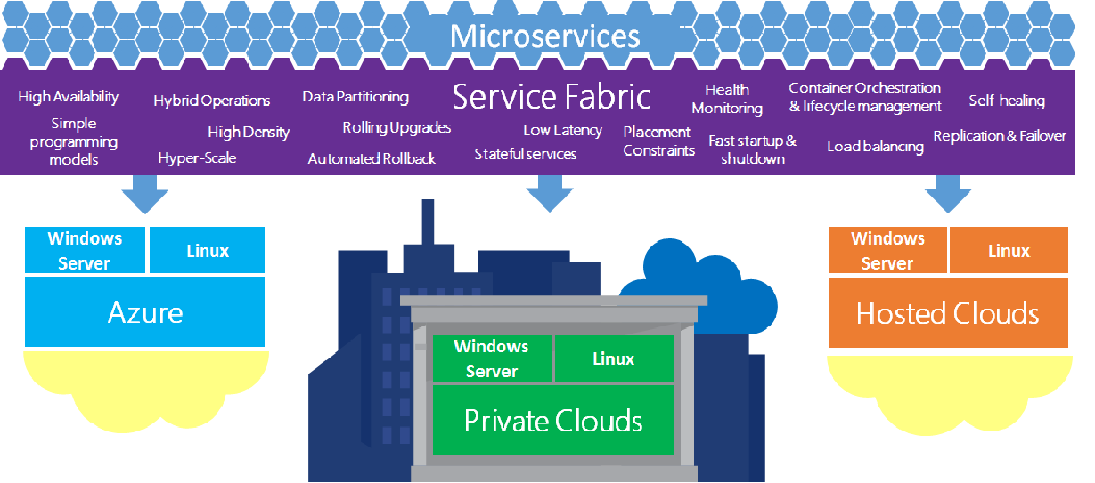
Service Fabric Anywhere
Notes:
So, what’s the idea of Service Fabric? To be able to effectively compartmentalize different components of a complex application, so each isolated component can scale independently.
Service fabric provides a wealth of features built-in and abstracted away from the developer to allow for all of the things you see in this diagram.
Better still, you can host service fabric on-prem, on windows or linux servers, or in the cloud. When you run it locally and debug on your machine, the local cluster that is installed and run is the same runtime that runs up in Azure.

Slide 7
What is Azure Service Fabric?
Microservice-based application development
Low-latency, massive scale
Decompose app into small, independent services
Used broadly for existing Azure offerings
Notes:
So it’s microservice-based development. Instead of having one monolithic service, even one hosted in an Azure WebApp, it provides a framework for automatically handling large numbers of virtual containers of various types.
The basic idea here is that you have a cluster of virtual machines running the Service Fabric runtime. They all combine to provide an available pool of resources, and each microservice, compartmentalized as a virtual container, draws from that pool of resources for the duration that it’s needed.
I spun up a cluster in Azure that uses 5 virtual machines, but you can create a much larger cluster, with potentially dozens of high-power VM’s, providing a huge amount of scalability and especially resiliency.
It’s definitely telling that Microsoft is really eating their own dog food here; Service fabric is already used for a lot of their existing offerings, like DocumentDB, Azure SQL, Skype for Business, and quite a few more.

Slide 8


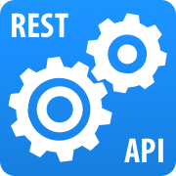
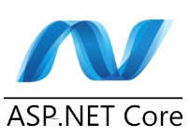
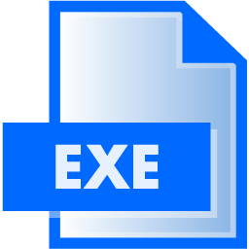
What Can You Build?
All supported within Service Fabric
Reliable Actors
Stateless/Stateful Reliable Services
.NET WEB API
Web Applications
Guest Executable
Notes:
High-level – what would you use Stateless/stateful services for? Or a Reliable Actor? Talk about examples – where are they used in the industry? Good place to talk about or uses, or how the Halo 5 servers use reliable actor pattern.

Slide 9
Reliable Services
Service Fabric’s bread and butter
Reliable
Available
Scalable
Consistent
Stateless and Stateful options
Notes:
Reliable – service stays up even with sub-optimal conditions, because the Service Fabric runtime handles fault tolerance, bringing up and down services, etc
Available – the Service Fabric runtime guarantees a degree of availability, due to multiple nodes being available.
Scalable – services are decoupled from hardware, and can be grown or shrunk as necessary – they’re easily partitioned to respond to demand and independently scale and respond to demand
Consistent – Stateful service storage is guaranteed to be consistent
Stateless vs Stateful – main difference is that Stateful has state available to it in the form of reliable collections – persisted across all instances of the service, because it’s transaction-based – I’ll show some code demonstrating that later

Slide 10
Reliable Actors
Isolated Compute Units
Abstraction over stateful Reliable Service
Virtual Actor design pattern – Orleans
1000’s+ units independent scale
Virtual, not hardware
Automatic garbage-collection
Notes:
Abstraction over Reliable Services – most things hosted in Service fabric can be broken down into one of those two services
If you deploy a Web API, it’s created in service fabric as a stateless reliable service. Reliable Actors are stateful
Look up Orleans – code is on GitHub
Pattern is used for Halo 5 servers
Talk about how actors are started and garbage-collected virtually – when one stays inactive it’s closed down; when a new one is needed, one is started

Slide 11
Service Fabric Implementation
How to think about Service Fabric
Enforce loose coupling of services
Identify different requirements for scale
Identify dependencies, performance bottlenecks
How to implement a store?
Notes:
Diagramming –implementation of Video Store, components that are needed, how they fit together

Slide 12
Demo
Sample Implementation of a Video Store in Service Fabric
Web API, Reliable Service, Actor, .NET Core Web App
1000 foot view of Service Fabric
Notes:
Refer back to the diagram

Slide 13
Questions?
Tallan Contacts:
Dan Fluet
Cloud Practice Director
dan.fluet@tallan.com
Matt Allen
Director of Boston Region
matt.allen@tallan.com

Slide 14
Event Hub, Stream Analytics
Notes:
it’s important to think about how to string pieces of azure together to accomplish complex tasks – i.e. connect event hub to stream analytics

Slide 15
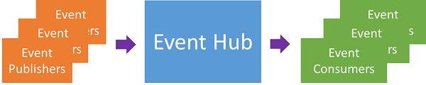
Event Hubs
Ingest 1,000,000’s of messages
Message stream handling
Similar to Service Bus queues/topics, writ large
Emphasize high throughput, event processing
Supports HTTP, AMQP

Slide 16
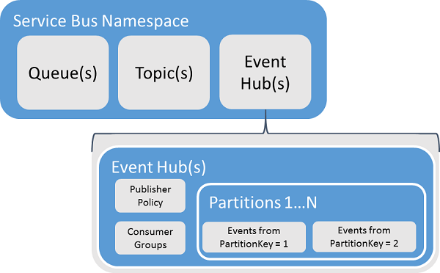
Event Hubs
Partitioned Consumers
Each partition holds events for set time
Event Publisher publishes events from hub
Notes:
Output from event hub supports HTTPS/AMQP
Talk about Shared Access Signatures

Slide 17
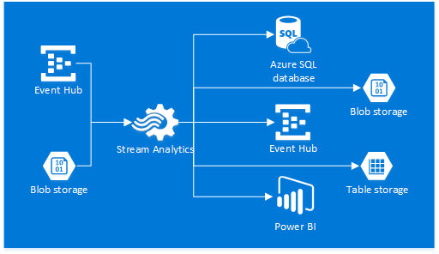
Stream Analytics

Slide 18
Stream Analytics
Identify patterns in large data on the fly
Ingest large amounts of data in a stream
Query data on the fly
Data in from Event Hub, etc
Output to Azure storage, HDInsight, etc

Slide 19
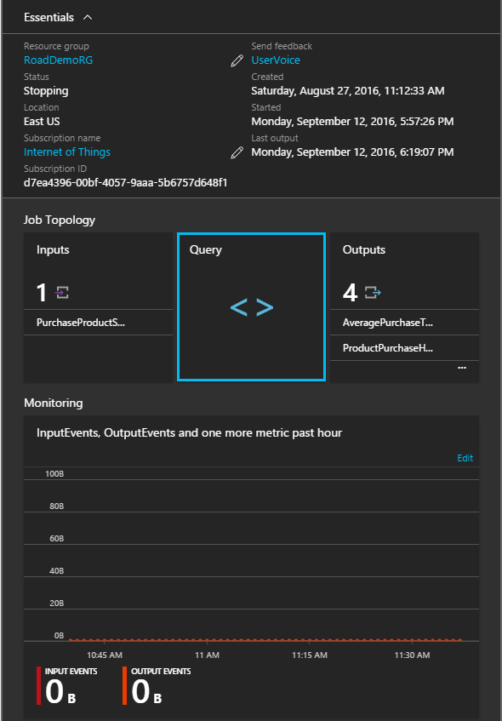
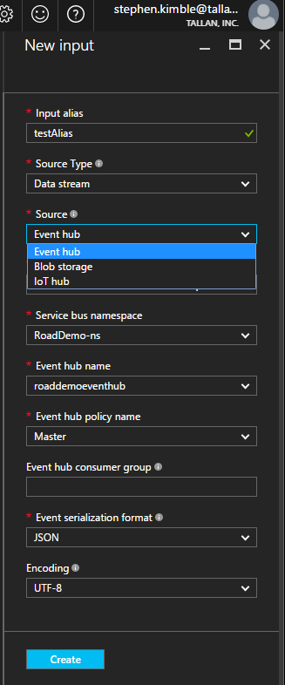
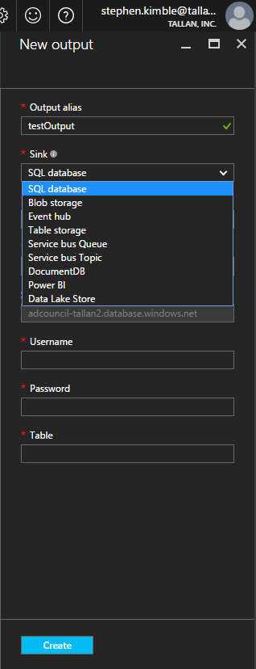
Connect Stream Analytics
Notes:
Inputs from Event Hub, IOT Hub (quickly talk about differences), local storage
Outputs to SQL, event hub, service bus, Data Lake, etc

Slide 20
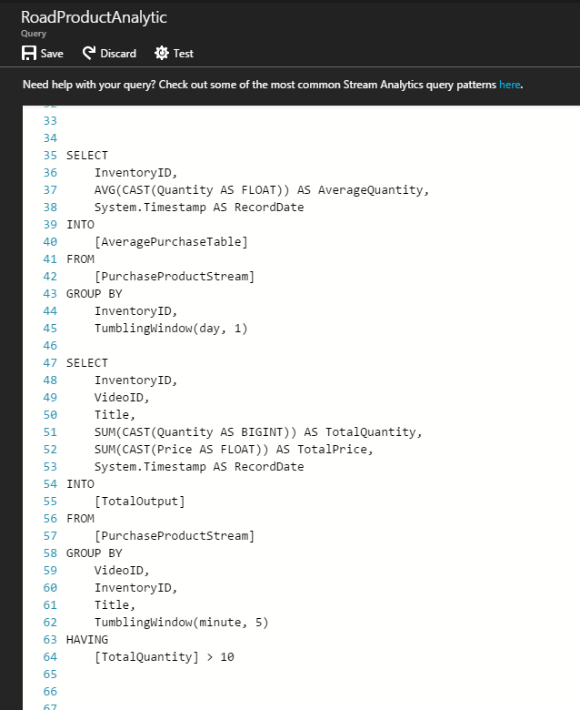
Write Queries
SQL-like syntax
Windowing on select timeframes
Conditional processing

Slide 21
Integrate with other Apps?
Link applications to an event hub to publish events
Service Fabric: Reliable Actors
Stream Analytics takes data from Event Hub
Conditional processing, output to different storage

Slide 22
Demo
Create Event Hub, linked to Service Fabric app
Create Stream Analytics job -- linked to Event Hub, storage account
Write queries against data
Notes:
Practical usage – what we’ve done in the past – fingerprint POC, Fielding systems, etc

Slide 23
Questions?
Tallan Contacts:
Dan Fluet
Cloud Practice Director
dan.fluet@tallan.com
Matt Allen
Director of Boston Region
matt.allen@tallan.com

Slide 24
Component Integration

Slide 25
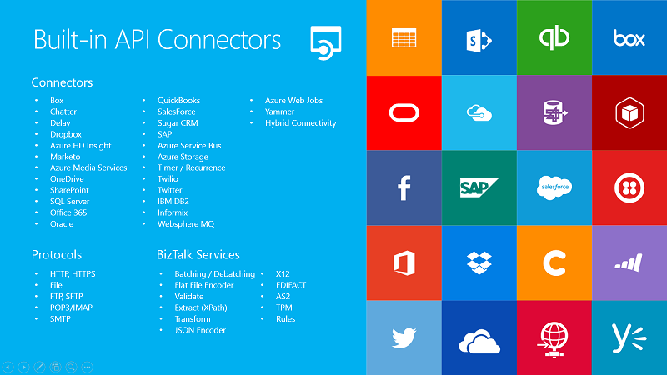
Logic Apps

Slide 26
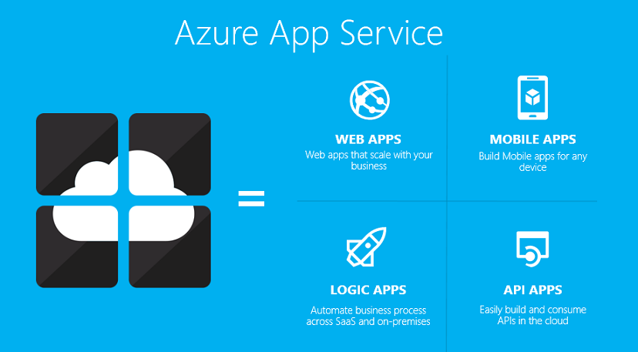
Logic Apps
Scalable Orchestrations in the Cloud
Create orchestrations with conditional logic
Dozens of built-in connectors
First-class support for Service Bus, API Management, other Azure offerings
Notes:
Talk about App Services – next step from Cloud Services – more managed, easy to develop on and deploy to

Slide 27
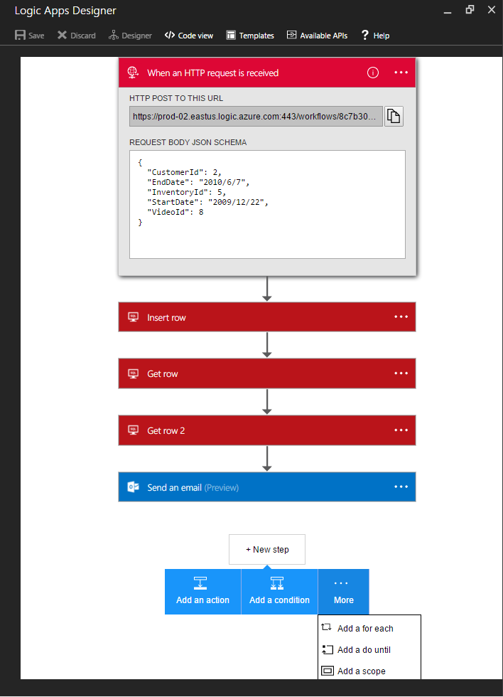
Easy UI for creating orchestrations
Graphical Interface and Code View
Trigger-based inputs from other services
Loops, Conditions, easy transformation of data

Slide 28
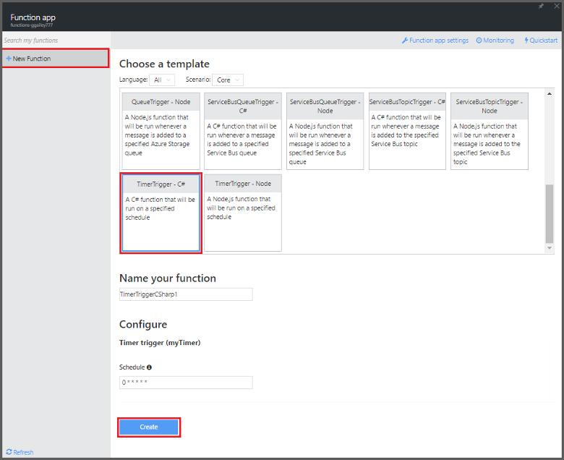
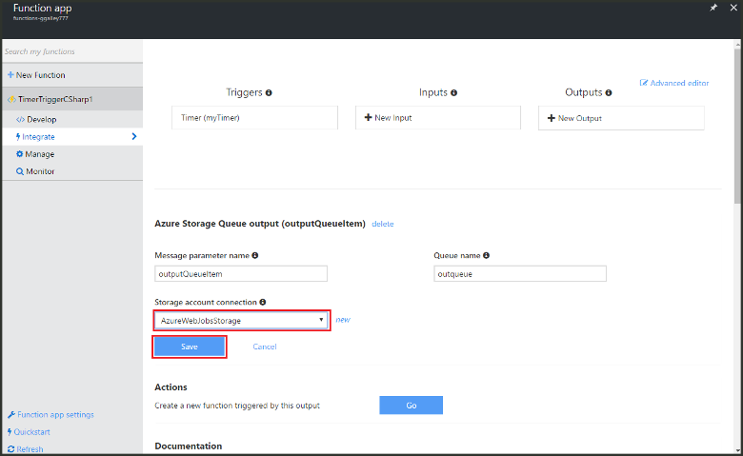
Azure Functions
Scalable Orchestrations in the Cloud
Similar to Logic Apps, but with more flexibility
Can use C#, Python, Node.js, etc
Pay-per-use
Notes:
Similar to Logic Apps, running within the aegis of App Services
Logic Apps are configuration-first – good for building orchestrations with other services,workflows, etc (Microsoft Flow is built on top of Logic Apps, is more user-friendly, don't need developer support)
Functions is code first – you write and deploy code to Azure App Services, which runs it on-demand (Functions are an evolution on WebJobs and improve upon them)
Functions support many different languages and technologies – NuGet and NPM are supported
Pay-per-use – can either pay dynamically, or include them on an existing App Service plan for little to no extra cost.Even the dynamic pricing grants you a million executions free per month.

Slide 29
Compare/Contrast
Confused Yet?
 | Logic Apps | Azure Functions | WebJobs
 | Standalone, orchestration component | Standalone, code-first model | Within existing App Service plan, code-first
Design Tool | In-Browser/VS | In-Browser, VS | VS
Deployment from source control? | X | X | X
Pricing | $/action (~$.0008/action) | $/action or App Service Plan | Part of App Service Plan
Languages |  | C#, F#, JS, etc (others experimental) | PowerShell, C#, PHP, Python, JS, Java
Run-type | Triggered, Scheduled | Triggered, Scheduled (Timer) | Triggered, Scheduled, Continuous
Trigger events | Bunches (dozens of connectors from other sources) | DocumentDB, Event Hubs, HTTP/WebHook, App Service Mobile Apps, Notification Hubs, Storage, Service Bus | Azure Storage, Service Bus

Slide 30
Demo
Send HTTP Post messages to Logic App
Connect Stream Analytics to Service Bus Queue
Pull messages off Queue with Logic App, send notification
Notes:
Twitter, fix Twilio notification

Slide 31
Questions?
Tallan Contacts:
Dan Fluet
Cloud Practice Director
dan.fluet@tallan.com
Matt Allen
Director of Boston Region
matt.allen@tallan.com

